Slide 1







Responsible Design
Designer Too
Oussama RAHOU
Étudiant 5eme année médecine

Slide 2



1
NOT Responsive Design

Slide 3

2
Who the heck I am?
A student 5th year Medicine!!
Graphic & Motion designer since 2010.
“Designer Too”
@Videohive / envato @alanis TV
@ISSAL
@DirassaTic
….

Slide 4
Who a «Designer» is ?
3
Every one with the power to create something, or make it better (or even make it worse)

Slide 5

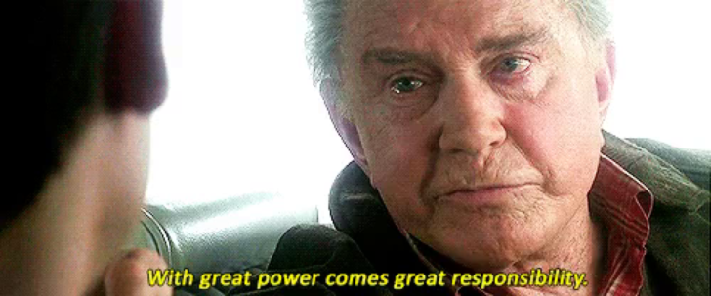
With great power comes great responsibility.

Slide 6


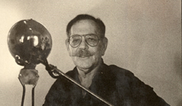
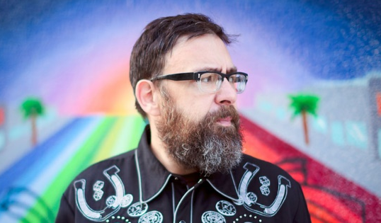

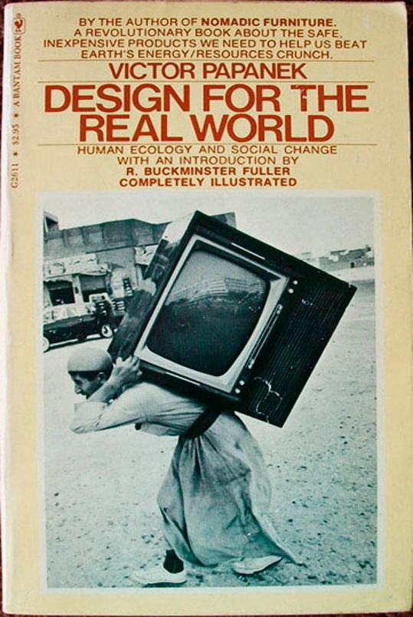


History
4
Victor Papanek:
Design for the Real World
Mike Monteiro:
Design is a job

Slide 7

Stories teach us
5
Y2K «year 2000 bug» (the millennium bug)
It costed 308billion to prepare for Y2K
Because of what?
Because of “It just works”!!
2038 might be the next bug… 32bit systems should be dead these days

Slide 8

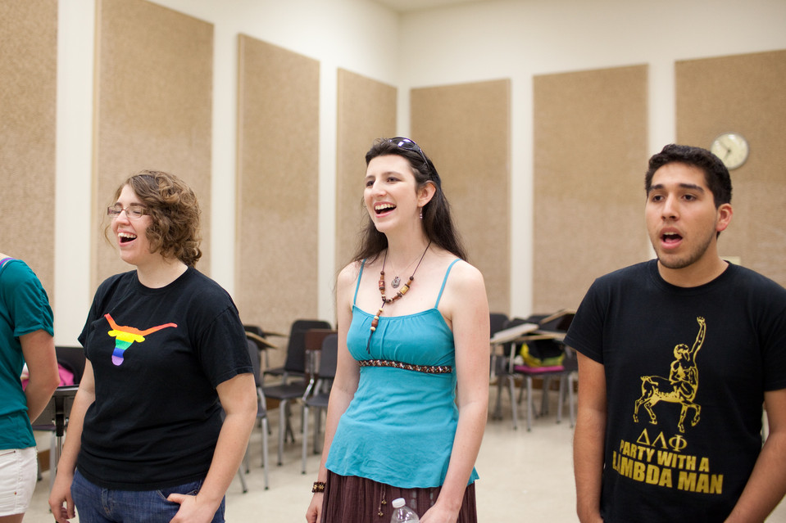
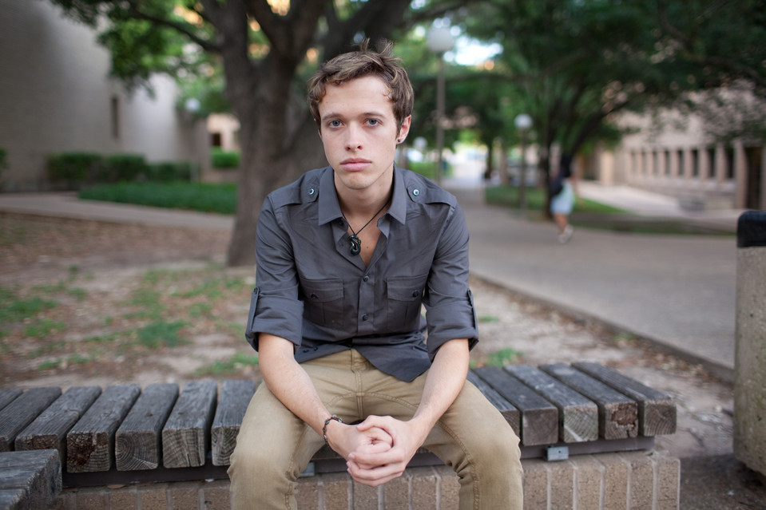
Stories teach us
5
When the Most Personal Secrets Get Outed on Facebook
10% of Fb users don’t understand its privacy settings..
That’s more than 100 000 000 users

Slide 9
"Our hearts go out to these young people.. Their unfortunate experience reminds us that we must continue our work to empower and educate users about our robust privacy controls."
Facebook spokesman Andrew Noyes

Slide 10
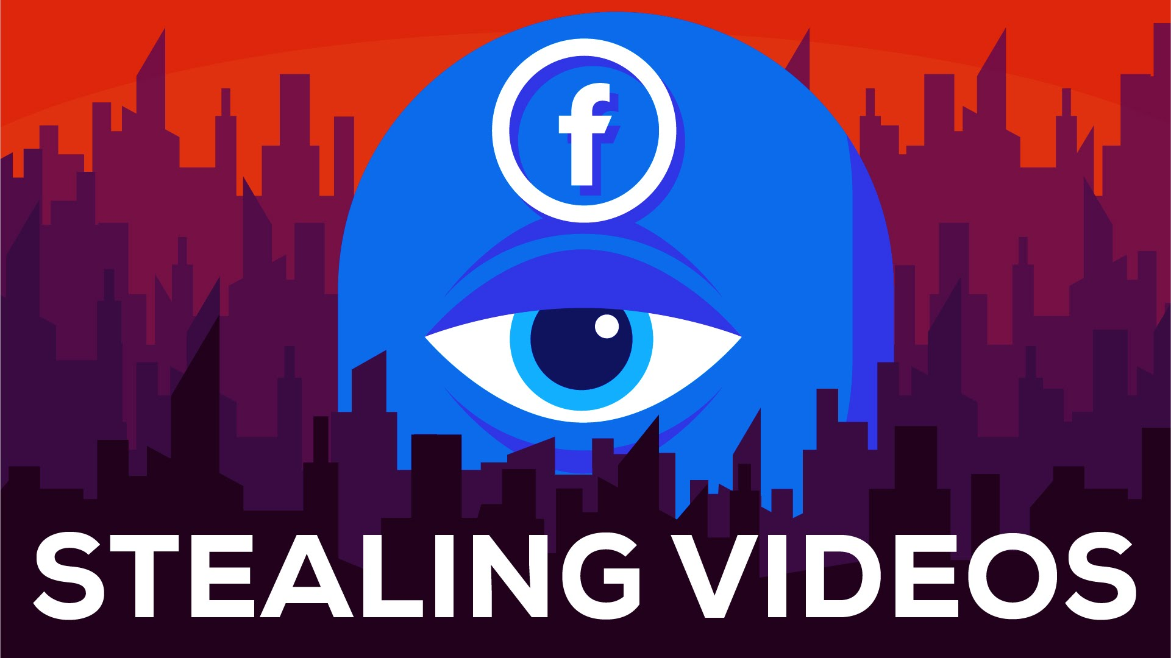
Stories teach us
5
How Facebook is Stealing Billions of Views
Nov 7th, 2015 Facebook announced 8 billion video views per day
80% of these videos are stolen from Youtube creators
How Facebook is Stealing Billions of Views –
https://www.youtube.com/watch?v=t7tA3NNKF0Q

Slide 11
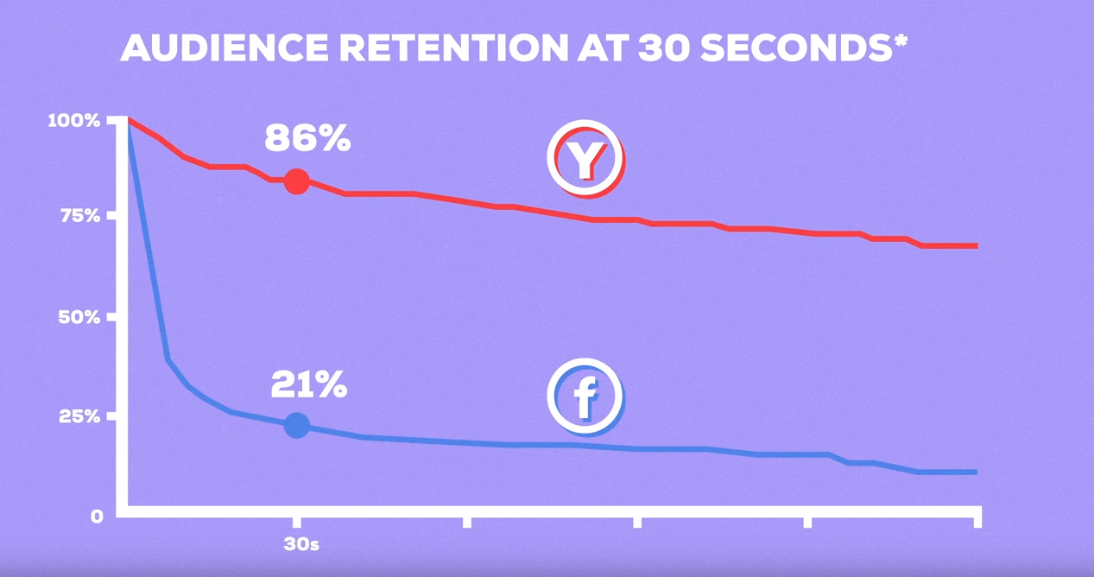
DATA by Hank Green

Slide 12
Ask yourself
6
“what do I want to create, and not to create?”

Slide 13

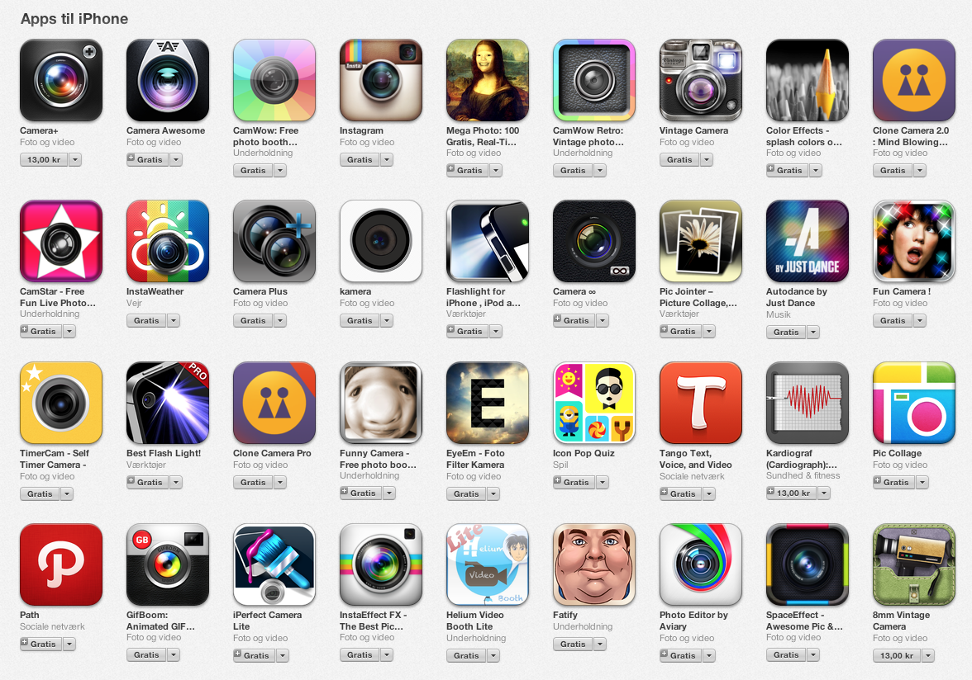
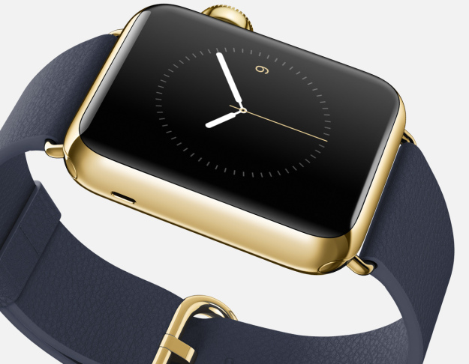

Slide 14
How to be a responsible designer!
7
Design is to solve problems..
Don’t be afraid saying NO
Learn from those who came before.. Inspire those who come next

Slide 15
«كلكم راع وكلكم مسؤول عن رعيته»
متفق عليه

